Slide 1


RESTAURANT TABLE RESERVATION SYSTEM
PRESENTED BY
SWAATHI S [2303811710422164]
THANUJA V [2303811710422168]
VISHALINI V [2303811710422180]
SUPERVISOR
MRS. V.KALPANA

Slide 2

PRESENTATION OVERVIEW
Problem Identification
Architecture diagram
Modules
Module description
5. Diagrams
6. Output

Slide 3
PROBLEM IDENTIFICATION
Traditional restaurant reservation methods cause inefficiency and dissatisfaction due to manual errors like double bookings, unclear costs, and difficulty handling multiple reservations. Customers lack options for personalized preferences (e.g., seating type, AC/Non-AC, themes), while staff struggle with real-time table tracking and administrators lack centralized payment and reporting systems. These issues result in delays, mismanagement, and poor customer experiences, highlighting the need for an automated Restaurant Table Reservation System.

Slide 4
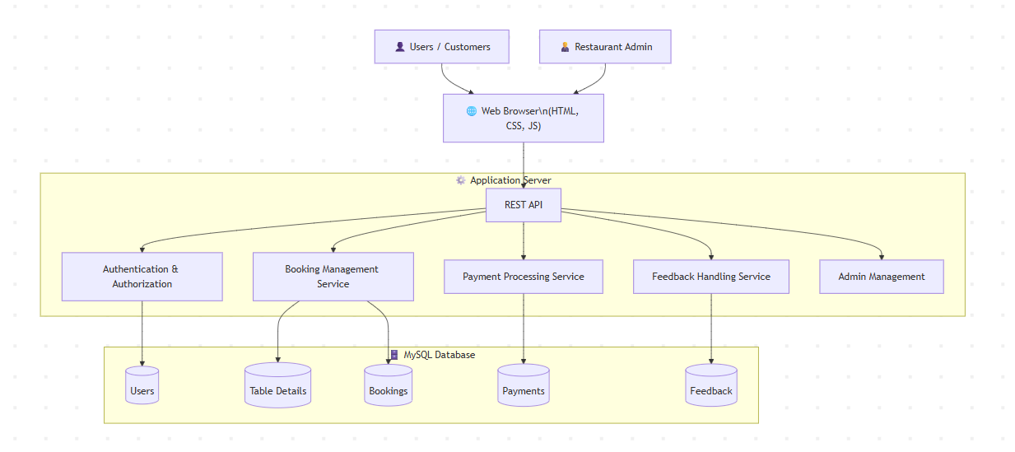
ARCHITECTURE DIAGRAM

Slide 5
MODULES
User Module
Table Booking Module
Payment Module
Feedback Module
Admin Module

Slide 6
MODULE DESCRIPTION
1.User Module – This module allows customers to register, log in, and manage their profile. Users can browse booking features, make reservations, view booking history, complete payment, and submit feedback after dining.
2. Table Booking Module– Users can select date, time, number of guests, special occasion (Birthday/Anniversary/Business Meeting), ambience (Romantic/Family/Quiet/Party), and seat preference (Window/Outdoor/AC/Non-AC). The system confirms and saves the reservation in the database.
3. Payment Module– This module handles advance payment through a simulated card payment page. It verifies entered details and updates booking status to indicate payment completion.
4. Feedback Module– After dining, users can provide a star rating and comments about their experience. The system stores this feedback for admin review to improve service quality.
5. Admin Module– Admin can log in securely to view all bookings, manage reservation status, review customer preferences, and read feedback. This helps staff prepare tables, decorations, and maintain customer satisfaction.

Slide 7
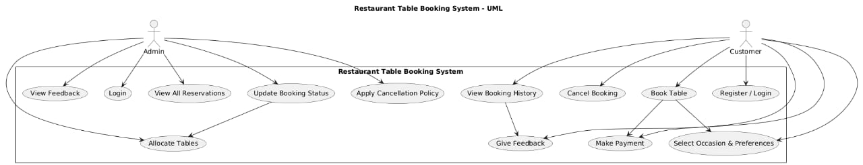
USE CASE DIAGRAM

Slide 8
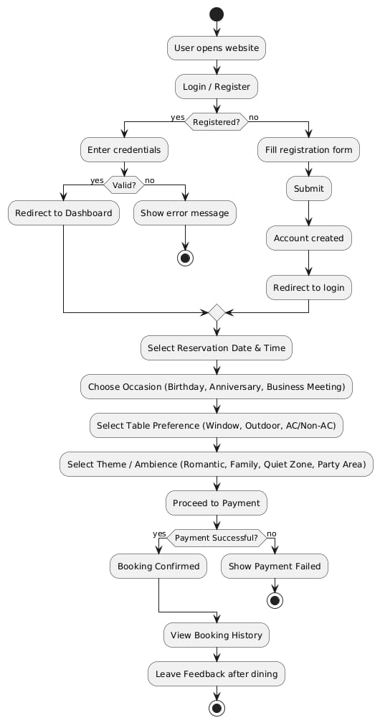
ACTIVITY DIAGRAM

Slide 9
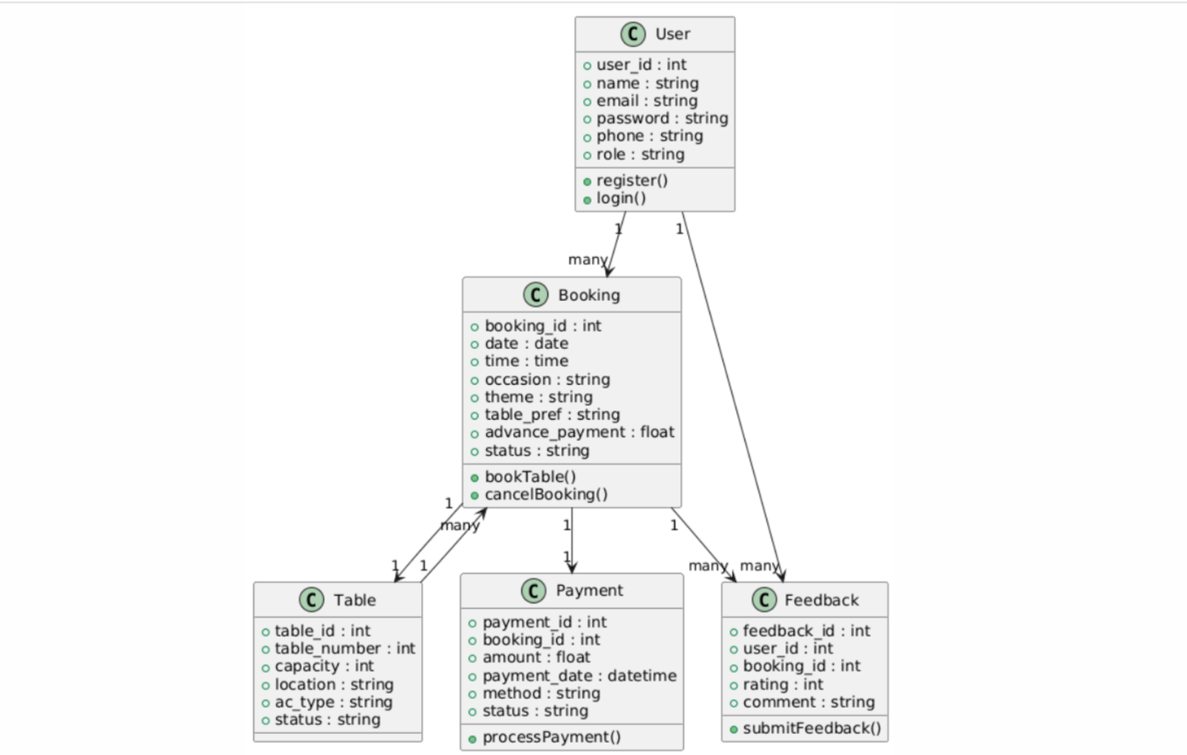
CLASS DIAGRAM

Slide 10
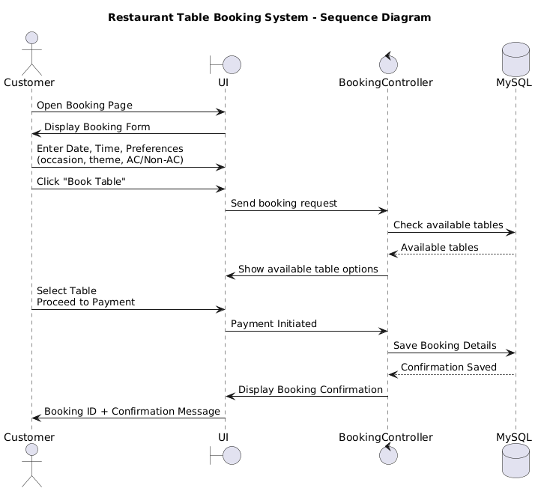
SEQUENCE DIAGRAM

Slide 11
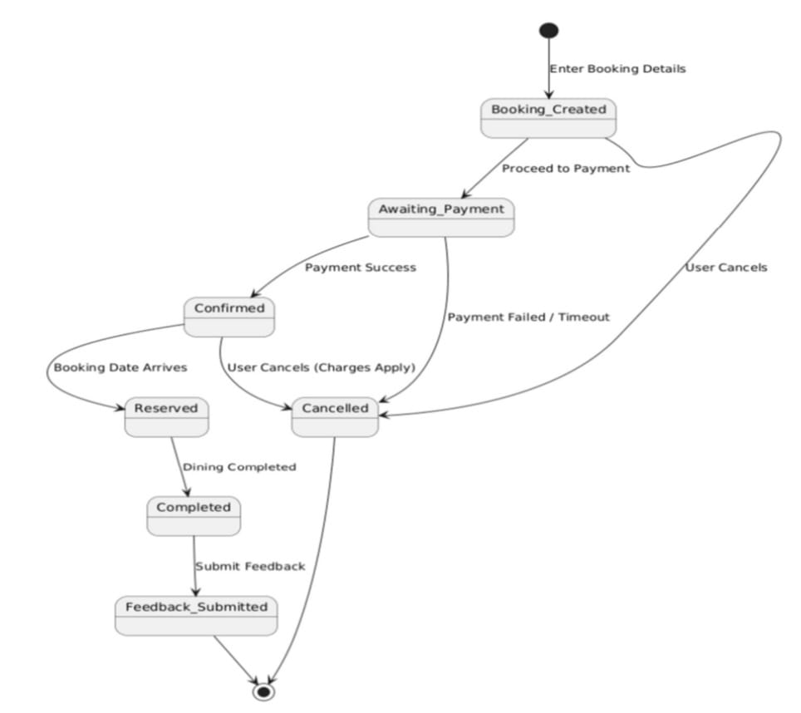
STATE MACHINE DIAGRAM

Slide 12
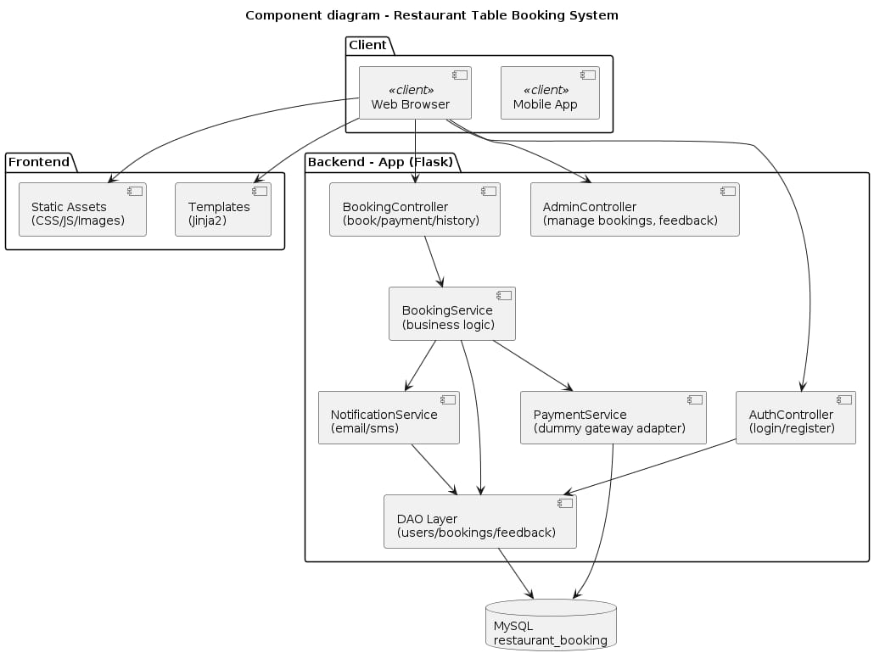
COMPONENT DIAGRAM

Slide 13
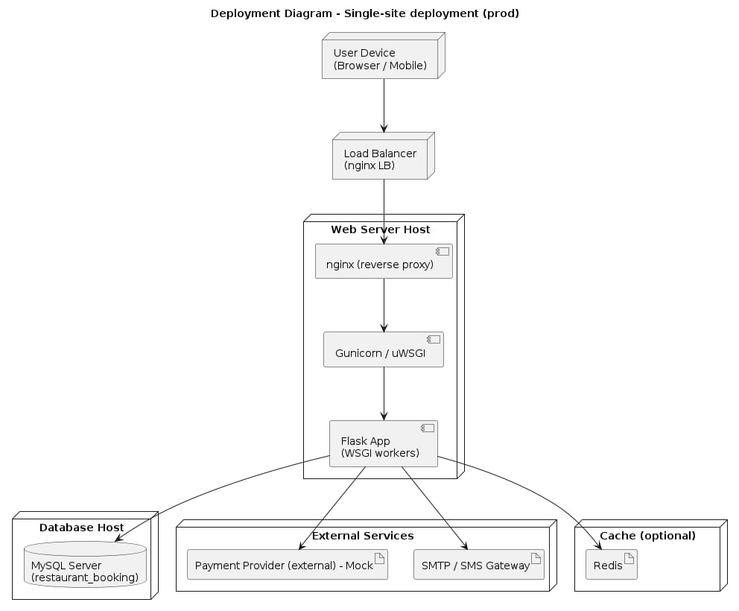
DEPLOYMENT DIAGRAM

Slide 14
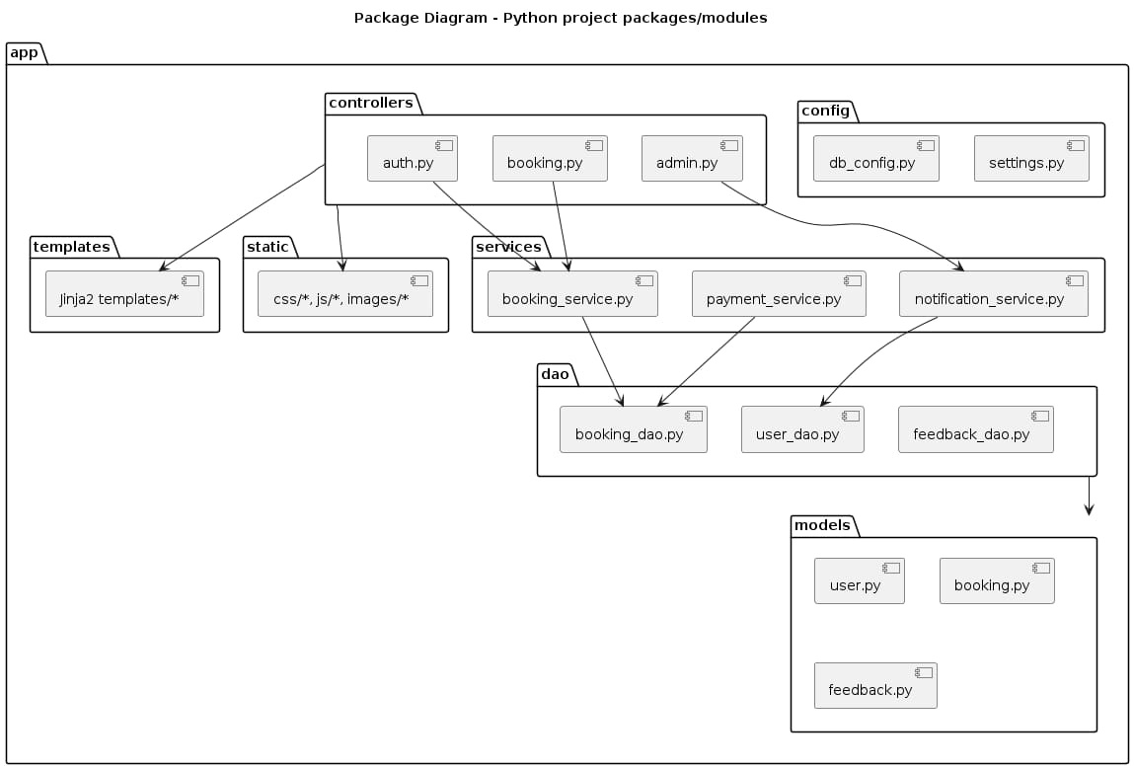
PACKAGE DIAGRAM

Slide 15
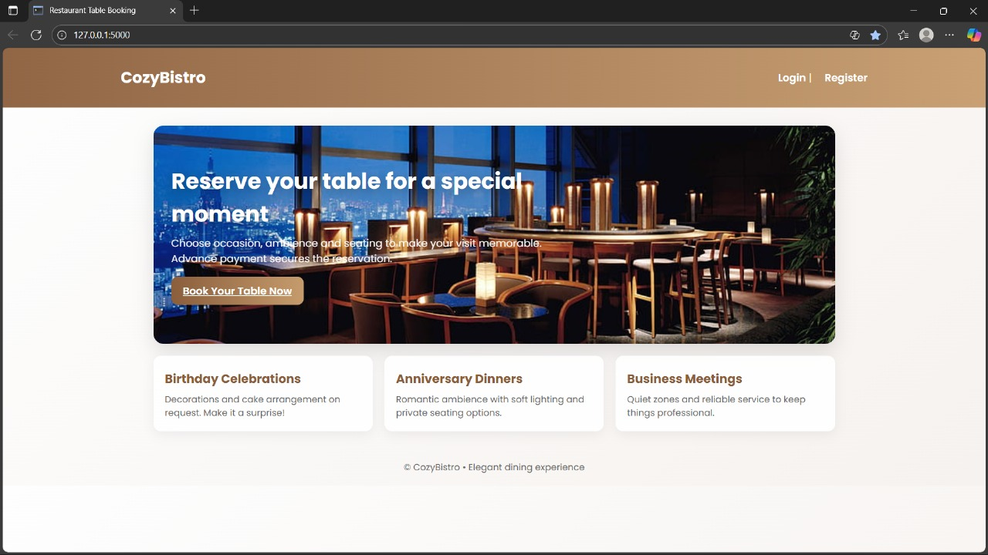
OUTPUT
1. DASHBOARD

Slide 16
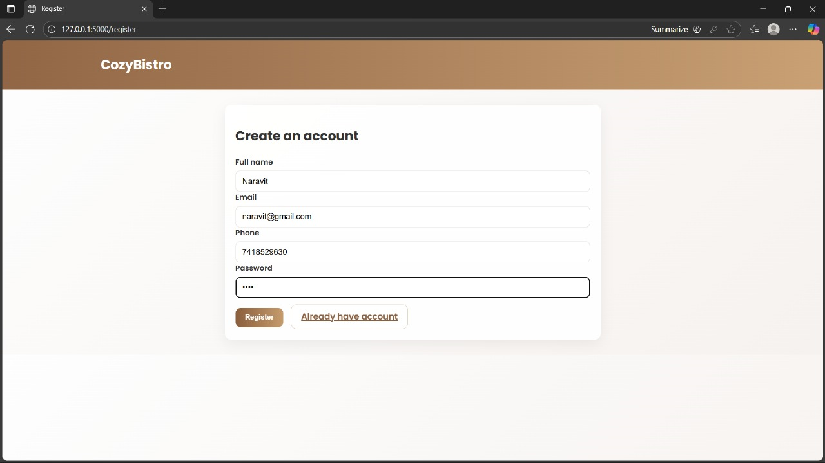
OUTPUT
2. REGISTRATION

Slide 17
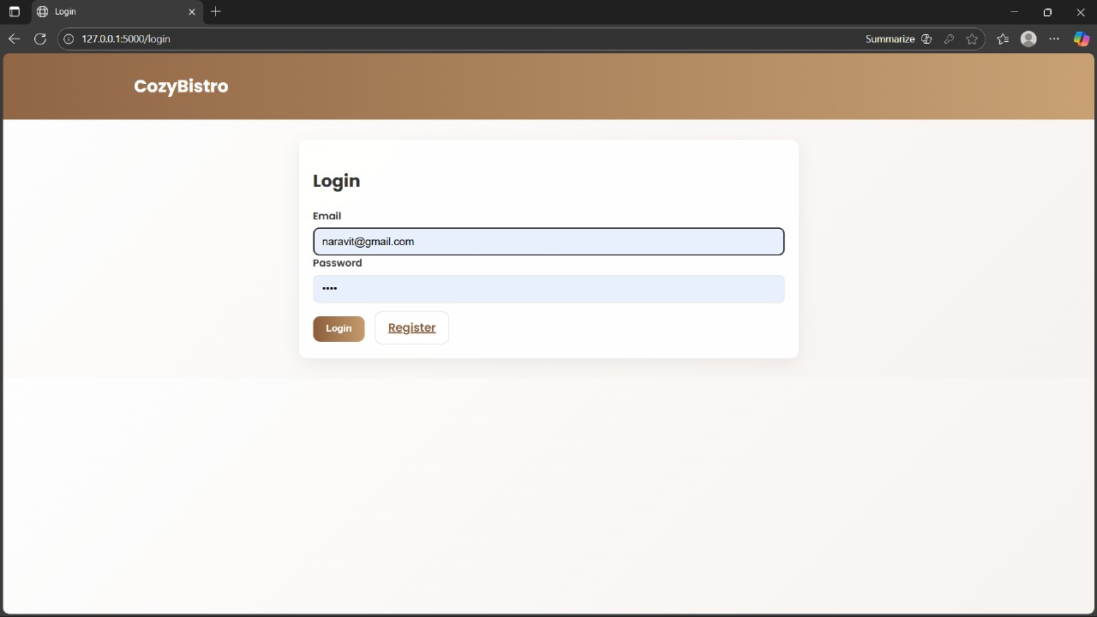
OUTPUT
3. LOGIN

Slide 18
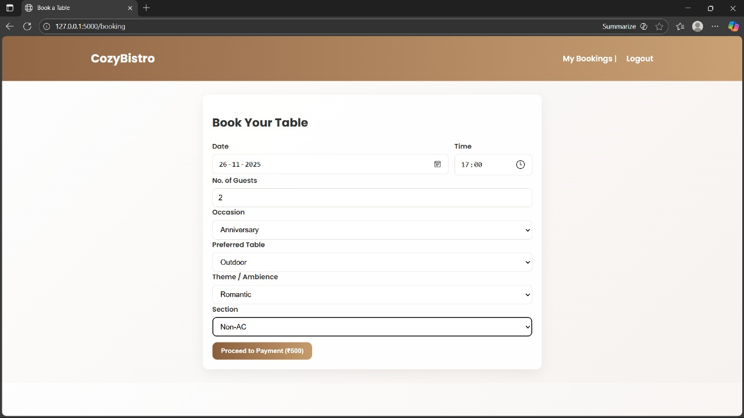
OUTPUT
4. CUSTOMER TABLE BOOKING

Slide 19
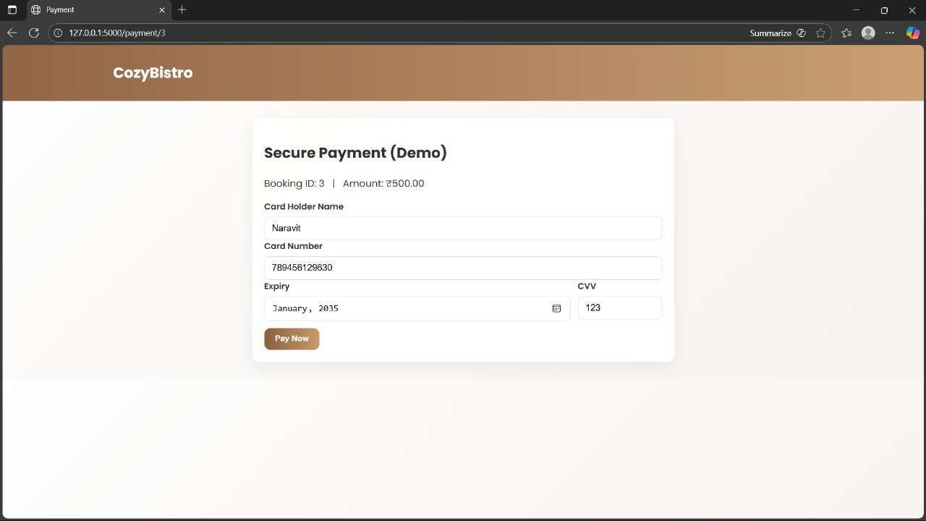
OUTPUT
5. PAYMENT

Slide 20
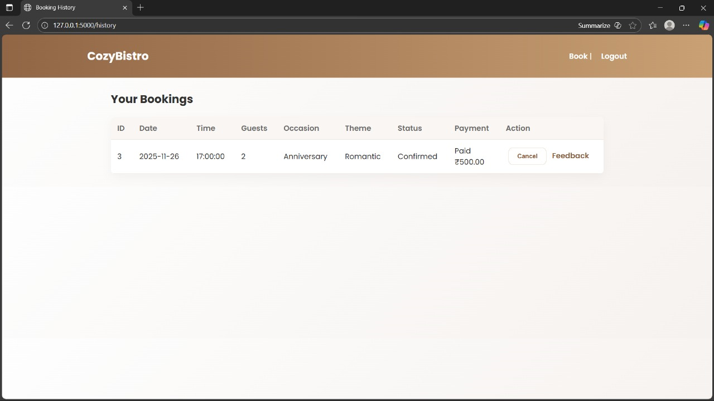
OUTPUT
6. CUSTOMER BOOKING HISTORY

Slide 21
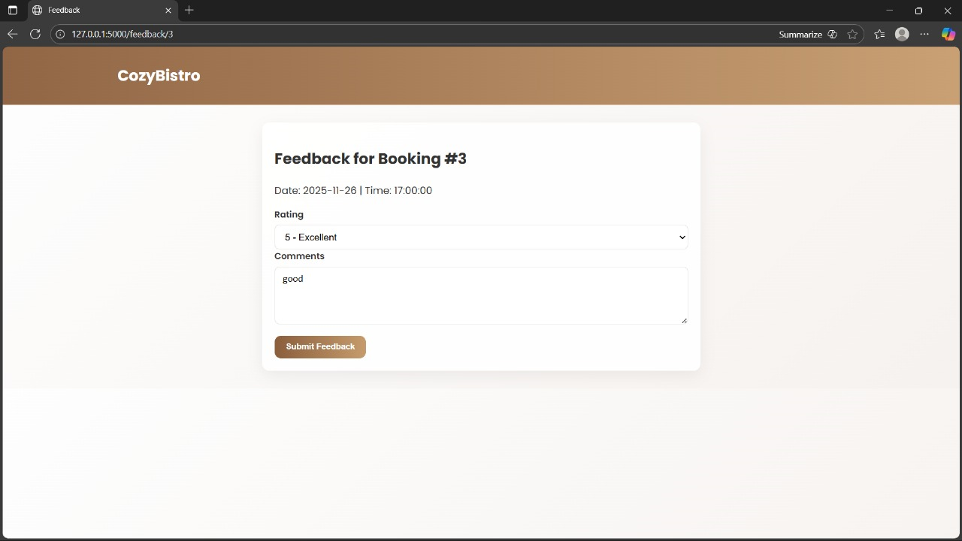
OUTPUT
7. FEEDBACK

Slide 22
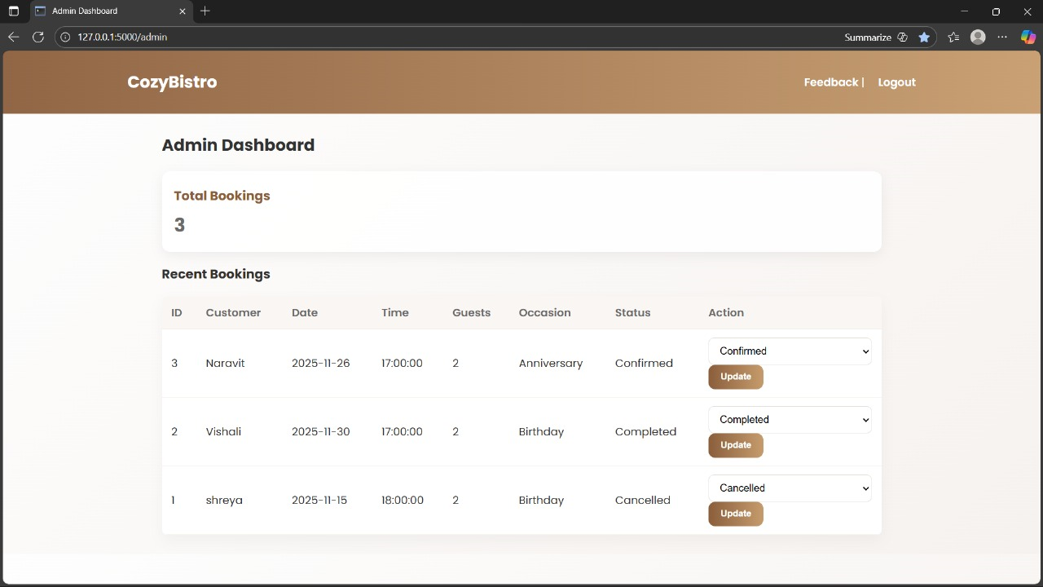
OUTPUT
9. ADMIN DASHBOARD

Slide 23
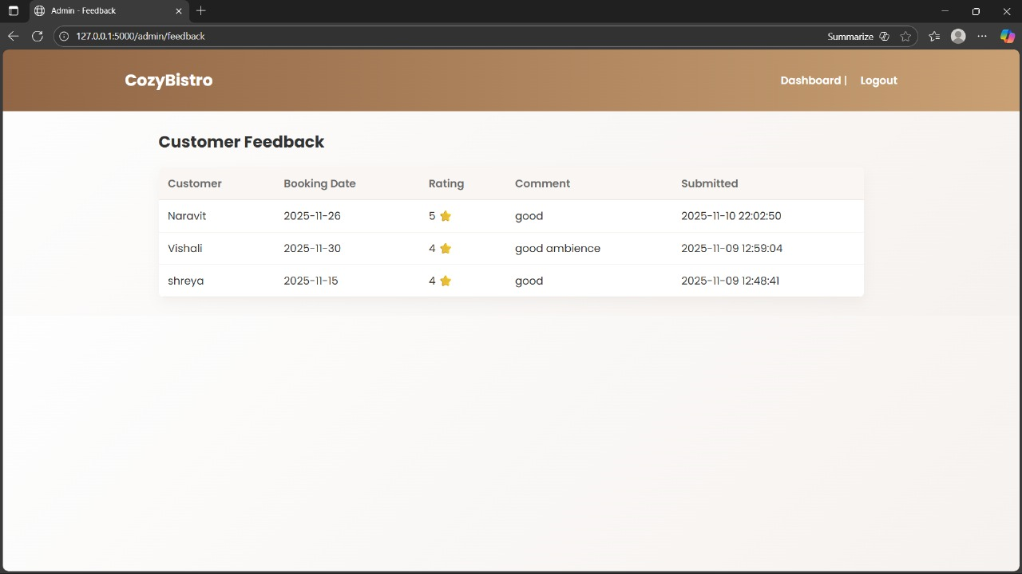
OUTPUT
10. CUSTOMER FEEDBACK

Slide 24
THANK YOU

